Slide 1
Introduction
What is the UK Data Service?
What data are available?
How to find and access this data
Copyright © 2023 UK Data Service. Created by UK Data Service, University of Manchester
Notes:
Hello everyone.
I’m Dr Jools Kasmire from the UK Data Service Computational Social Science training team, based in Manchester.
Today I’m going to talk to you about The UK Data Service and how it can contribute to an exploration of educational outcomes.
I’m going to start by giving a quick summary of what the UKDS is.
Then I’m going to give an overview of the data we hold and finally I’ll show you how to get started finding and accessing our data.

Slide 2
What is the UK Data Service?
a comprehensive resource funded by the ESRC
a single point of access to a wide range of secondary social science data
support, training and guidance
Notes:
The UKDS is a comprehensive resource funded by the Economic and Social Research Council, one of the many funded by UK Research and Innovation.
As such, we provide access to the largest collection of social, economic and population data in the UK.
Data providers deposit their data with us and then we make this available to users.
As well as providing access to all that data, the UKDS provides support, training and guidance to help researchers find, access and use this data.

Slide 3
Who is it for?
Academic researchers and students
Government analysts
Charities and foundations
Business consultants
Independent research centres
Think tanks
Notes:
So, who’s it for?
Well, we like to say it’s for everyone! This includes but is not limited to [read a bit off slide]

Slide 4
Sources of data
Official agencies – mainly central government
International statistical time series
Research institutions
Individual academics - research grants
Market research agencies
Public records/historical sources
Notes:
And our data comes from many different sources - such as [read off slide]

Slide 5
Types of data collections
Survey microdata
Cross-sectional
Longitudinal
Aggregate statistics
International data
Census data
Qualitative and mixed methods data
Other
Notes:
And we hold data of all different types - mostly survey data, both cross-sectional and longitudinal.
We also hold aggregate data, international macrodata, census data and qualitative and mixed methods data as well as a few things that don’t fit any of these categories very well.
So now I’ll just quickly cover how you can find and access all of these data from the UKDS.

Slide 6
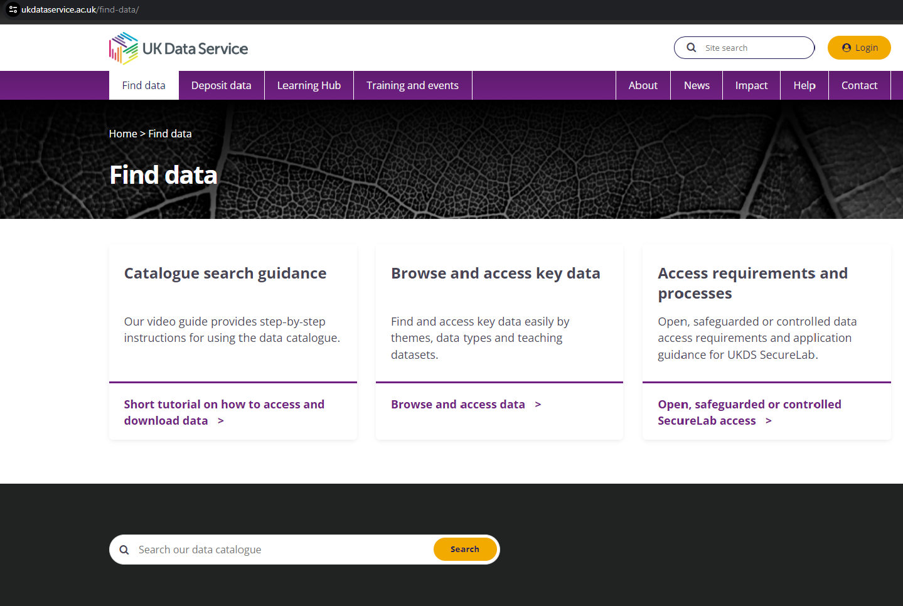
Find Data Tab
Notes:
If you don’t know how to get started, you can click on the “Find data” tab at the top which directs you to a few common options as well as some links to tutorials to learn more.

Slide 7
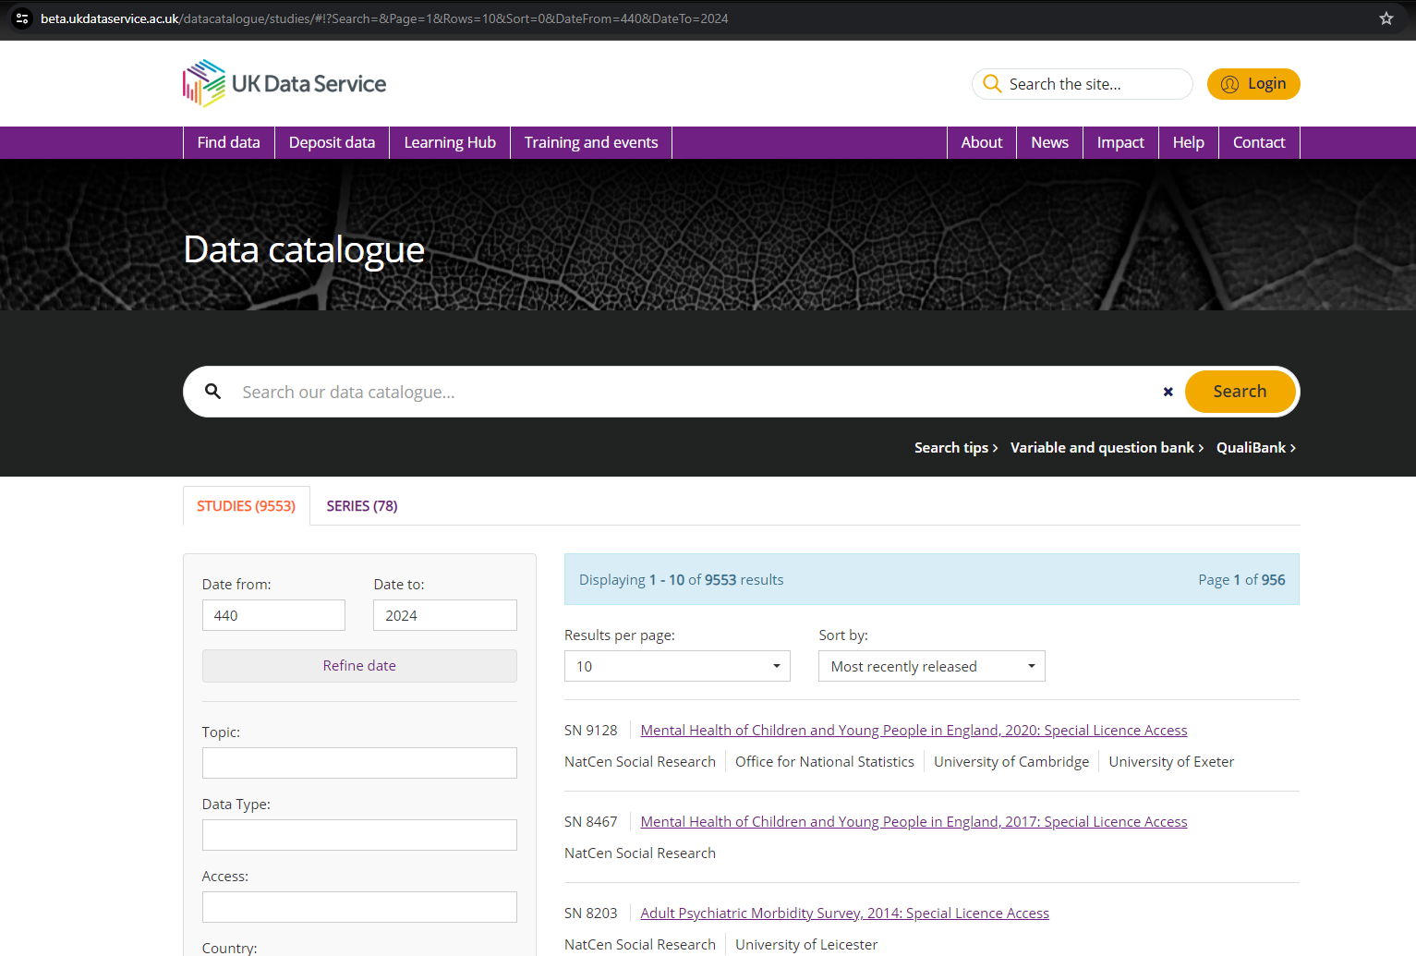
Catalogue Search Tool
Notes:
One of the most popular options is our catalogue search tool.
The catalogue search tool allows you to search the datasets available from the UKDS.
You can enter relevant search terms, search for particular datasets by name or study number.
You can also use the filters down the left-hand side to further refine your search.

Slide 8
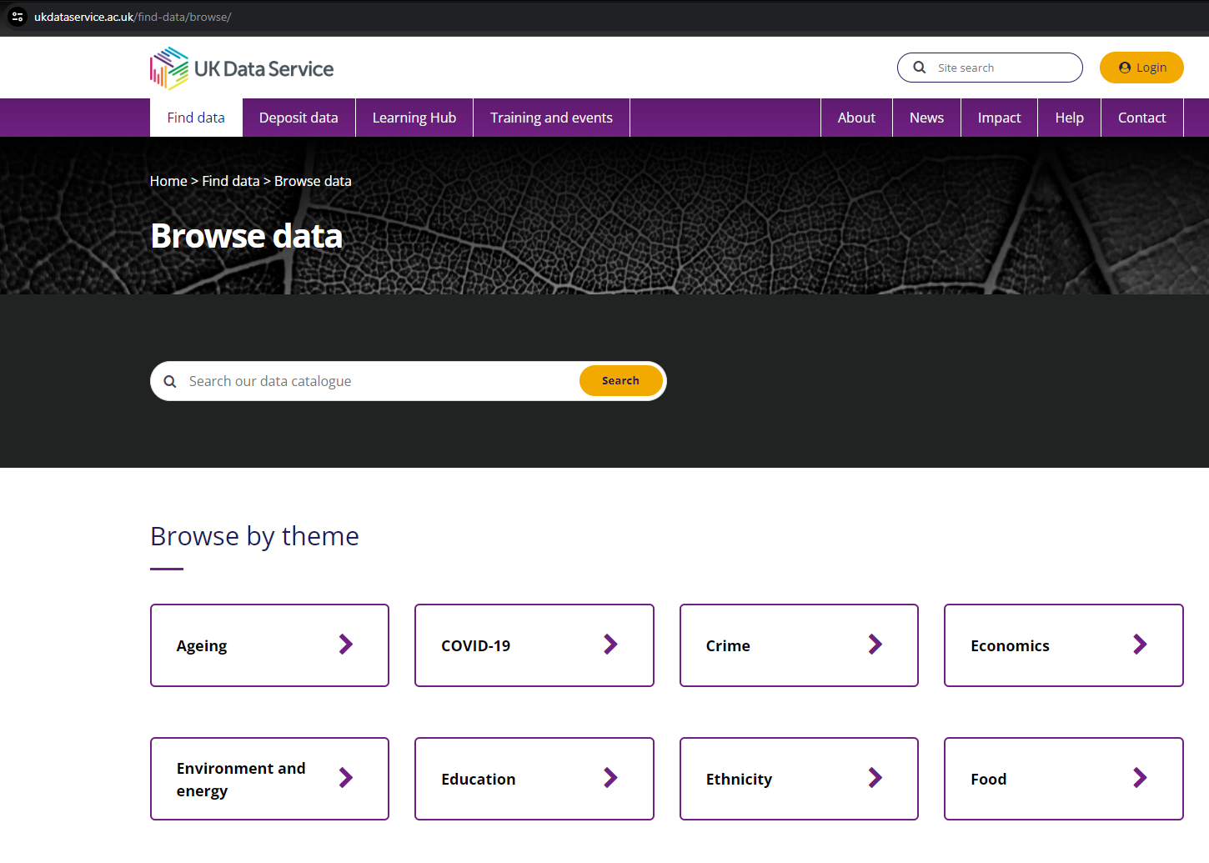
Browse by theme
Notes:
But you may also want to browse, which theme being the first browsing option presented to you. One of the top themes is ….
Education.
There are more themes if you scroll down… But if you KEEP scrolling down you find…

Slide 9
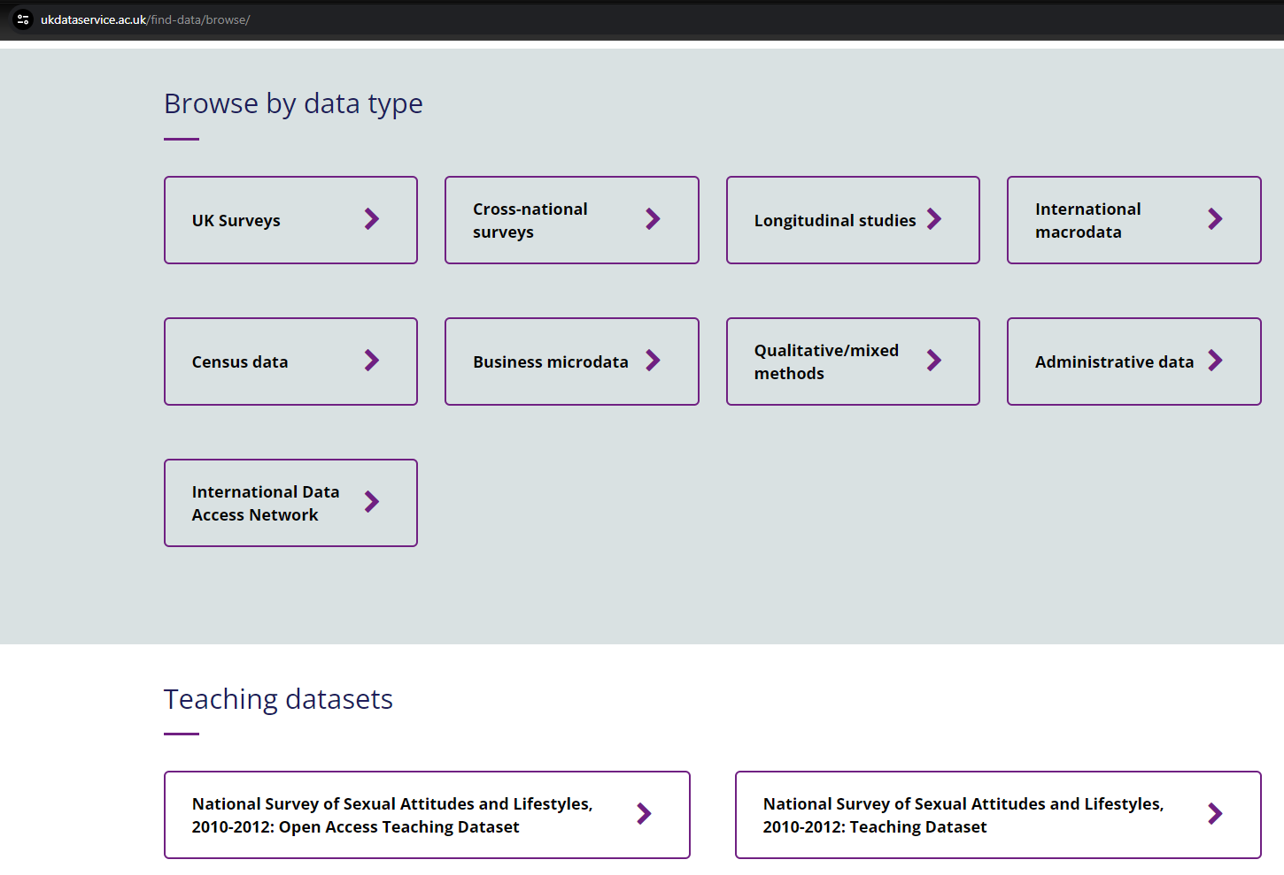
Browse by type
Notes:
You can also browse by data type. Keep scrolling down EVEN more to …

Slide 10
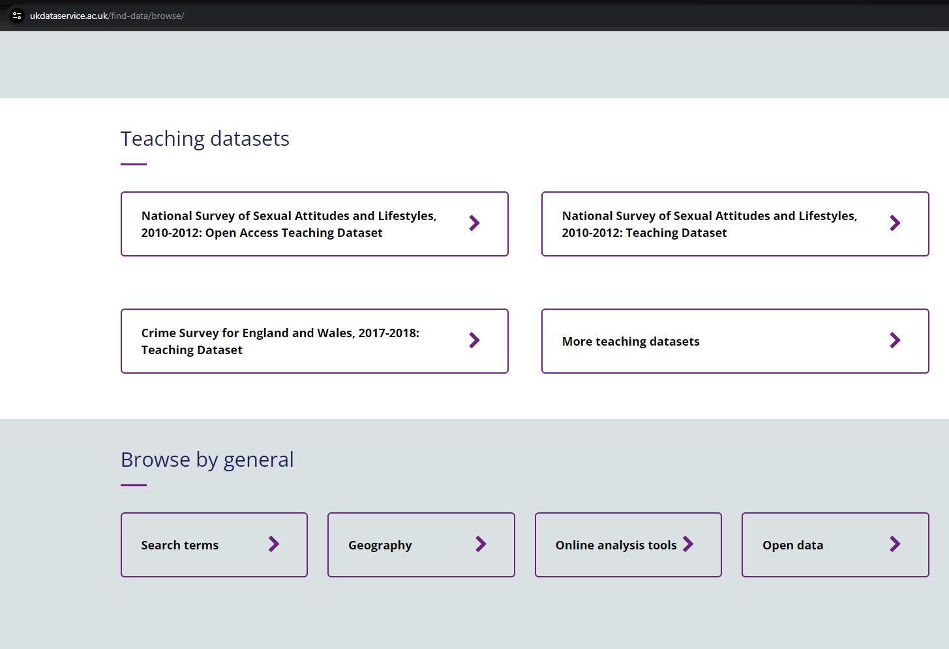
Browse teaching datasets
Notes:
Brows by teaching datasets and a few other categories that we have grouped together under ‘general’.

Slide 11
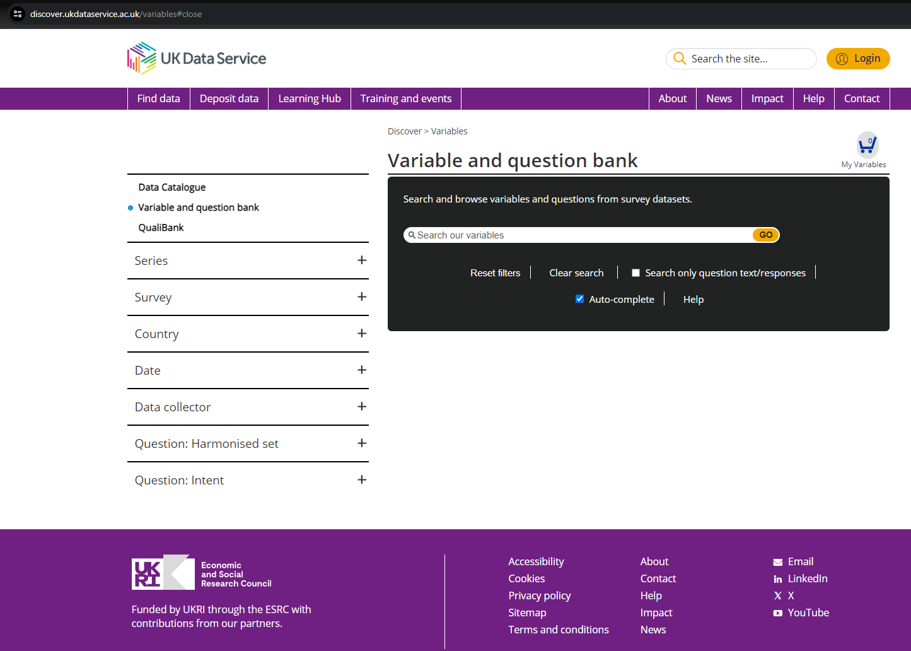
Variable and Question Bank
Notes:
You can also search for particular variables within datasets in our variable and question bank. For example, if we were to type in ‘Education’ we can see which datasets contain variables on this topic. Just a note on the VAQB though, this doesn’t contain all of the datasets we currently hold, so it’s worth searching the catalogue for later versions of datasets to double check.
The options on the left-hand side here that you can expand with these little plus signs are specific to the variable and question bank.
You can instead choose to search instead…

Slide 12
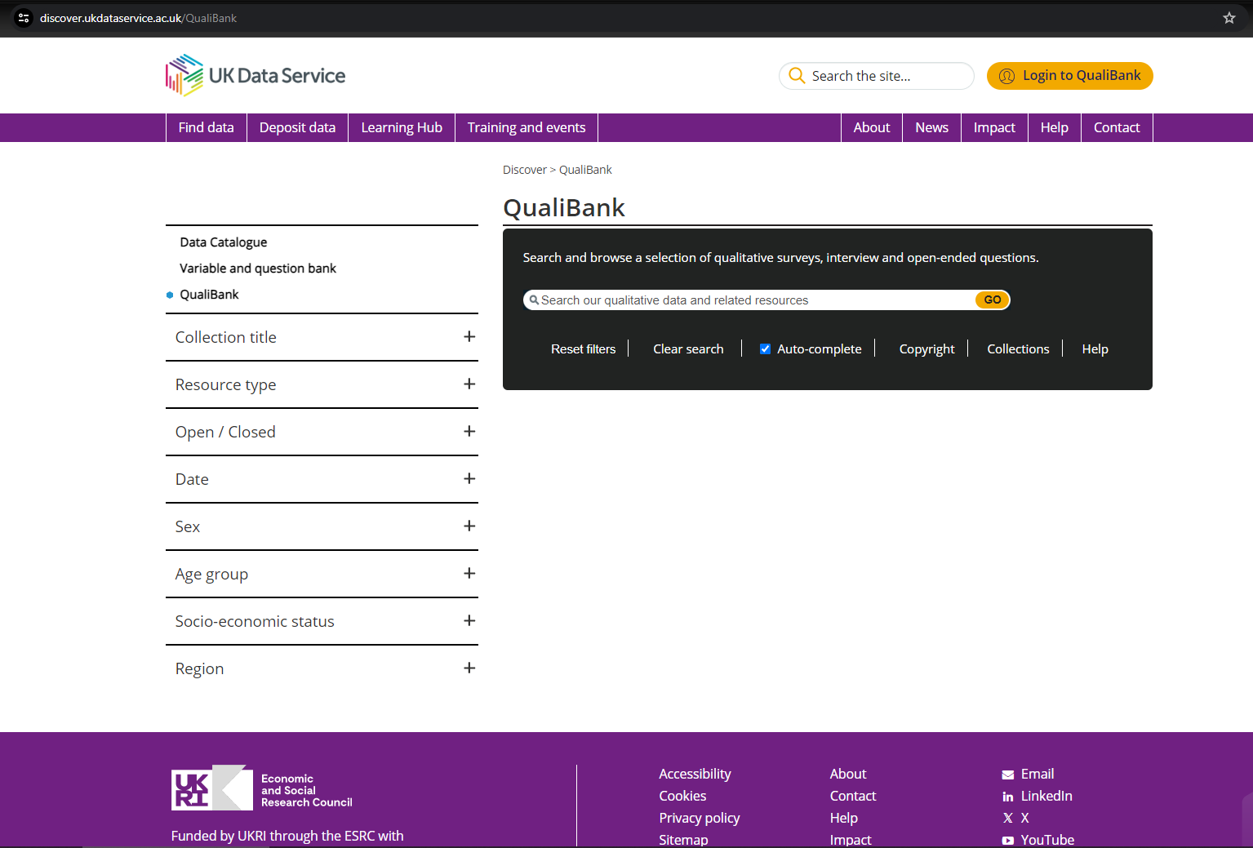
Qualibank
Notes:
In the qualibank. This is especially useful if you are interested in Qualitative data as it allows you to search key terms within different types of qualitative resources.
Note that here too the options and menus on the left are unique to the qualibank.

Slide 13
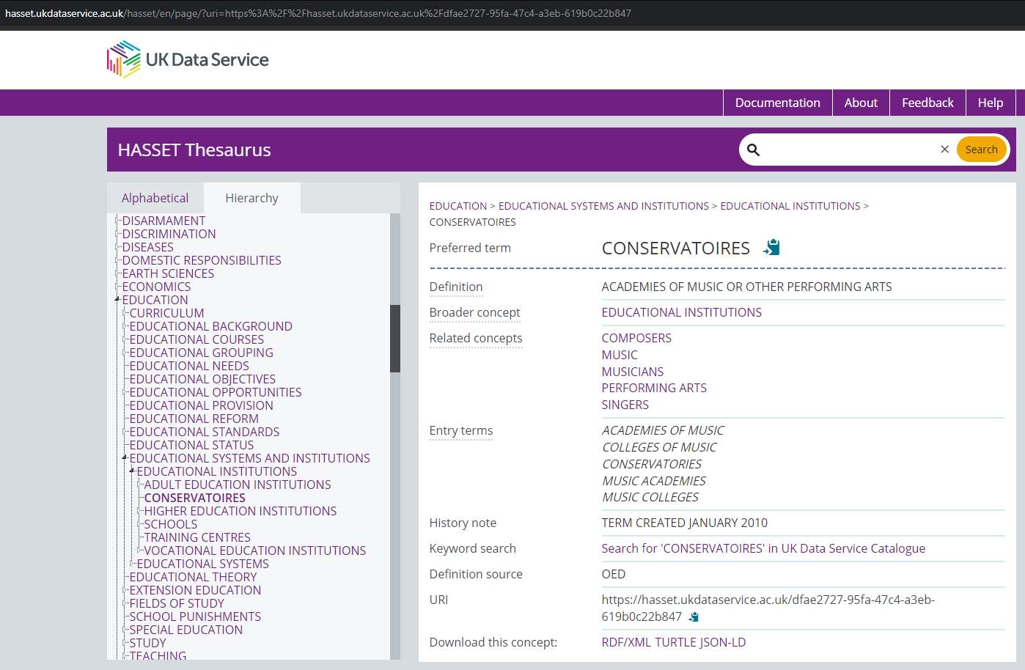
HASSET
Notes:
Finally, we have the HASSET thesaurus. HASSET stands for Humanities and Social Science Electronic Thesaurus, for those to whom it may not be obvious.
This search tool contains key social science terms and related concepts - for example here, CONSERVATORIES is categorised under EDUCATIONAL INSTITUTIONS, which is under EDUCATIONAL SYSTEMS AND INSTITUTIONS, which is under EDUCATION.
This nesting structure is clear when you look at this tool via the hierarchy tab. Alternatively, you can look at the thesaurus through the alphabetical tab, which is pretty self-explanatory.
The thesaurus is helpful to show you what other terms might be useful to search in the catalogue, either because they fall higher or lower in the hierarchy or because they are listed under the entry terms and related concepts.

Slide 14
Data Access Policy
Controlled data
Accessed via a Safe Room, SecureLab within the UK or the SafePod Network
Safeguarded data
End user licence (requires registration) and special licence (requires a form)
ReShare data
Access controls set by the data owner and can vary
Open data
Can be used by all without registering
Notes:
And just a quick point on the different data access levels.
Starting at the most restricted types, we have controlled data which is also called secure access data. This data can only be accessed through a Safe Room, SecureLab within the UK or the SafePod network.
Next, we have safeguarded data which is available through End User License. Access to this kind of data requires registration. Some of this data is also special licence data which has additional requirements.
There’s also ReShare data, which is self-depositied by data creators or owners. Access to and controls on this kind of data can vary.
Finally, the least restricted type is open data. This is data that can be accessed by anyone, even without the need to register.

Slide 15
How to register
Logging in via OpenAthens or Shibboleth
UK Universities
Some further education colleges
Some UK Government departments
Local authorities
UK Data Archive username
International researchers
Charities
Think tanks
Schools
Personal researchers
Commercial organisations
Notes:
Importantly, most of the data in our collections can be accessed free of charge.
You can simply register using your institutional log in.
If you don’t have an institutional log in, you can apply to get a UKDA username.

Slide 16
Thank you.
Dr. Jools Kasmire
j.kasmire@manchester.ac.uk
Notes:
Thanks all for listening and let me know if you have any questions.

